Slide 1
European Virtual Institute to study the neural basis of emotion
Marie Curie Innovative Training Network
Horizon 2020

Slide 2
Time (GMT) | Time (CET) | Duration | Session
09:00 - 10:30 | 10.00 - 11.30 | 1.5 hrs | Kick-off meeting
10:30 - 11:00 | 11.30 - 12.00 | 0.5 hrs | Break
11:00 - 12:00 | 12.00 - 13.00 | 1.0 hrs | Keynote lecture - Prof. Chris Miall
12:00 - 12.30 | 13.00 - 13.30 | 0.5 hrs | Break
12.30 - 13:30 | 13.30 - 14.30 | 1.0 hrs | Supervisory Board meeting

Slide 3
Kick off meeting
10.00 - 10.10 Welcome and overview of CEN Richard Apps, Network Coordinator
10.10 - 10.45 Summary of Research Objectives by work package leads
10.45 - 11.00 Partner organisation introductions
11.00 - 11.25 General discussion and questions
11.25 - 11.30 Provisional date for next CEN Network Meeting
(Paris, 7 – 9 July 2022)

Slide 4
Key aims of the consortium:
share and combine knowledge in the fields of cerebellar research and emotional disorders with close interaction between animal, computational and clinical scientists
use comparable behavioural paradigms and data analysis pipelines in all ESR projects
work co-operatively with our non-academic partners to enrich the training experience

Slide 5
CEN consortium in numbers:
8 European universities; 9 non-academic partners; 15 early stage researchers; 4.1 million euros over 4 years
Universities | Participants | Responsibility
Bristol, UK | Richard Apps (network coordinator), Vicky Walter (project manager) and Charlotte Lawrenson | Management, Research objective 1
Essen, Germany | Dagmar Timmann (deputy network coordinator) | Research objective 4
Edinburgh, UK | Peter Kind, Tom Watson and Sally Till | ESR Development
Paris, France | Daniela Popa and Clement Lena | Research objective 2
Pavia, Italy | Egidio D’Angelo and Lisa Mapelli | Research objective 3
Uppsala, Sweden | Tomas Furmark | Ethics
Stockholm, Sweden | Kristoffer Månsson | ESRs
Würzburg, Germany | Philip Tovote | Dissemination, Research objective 2
Non academic partners
Industry: | Blackrock Microsystems, Cerevance, Inscopix, 3Brain | Secondments, training
Hospital and charity: | Ataxia UK, DHAG, Euro-Ataxia, Patrick Wild Centre, Rehab Kettwig | Secondments, outreach, patient groups

Slide 7
Our overarching hypothesis is that internal models within the cerebellum regulate emotional behaviours and emotional learning by participating in the computation of prediction error.
Research objectives:
Cerebellar modules and behaviour: identify the cerebellar modules involved in emotional control; (Bristol)
Cerebellar-limbic pathways: establish how these modules are connected to other nodes of the emotional network; (Paris/Würzburg)
Cerebellar computations: decipher the computational operations taking place in these modules; (Pavia)
Pathophysiological mechanisms: determine how changes in cerebellar circuits contribute to emotional disorders. (Essen)

Slide 8
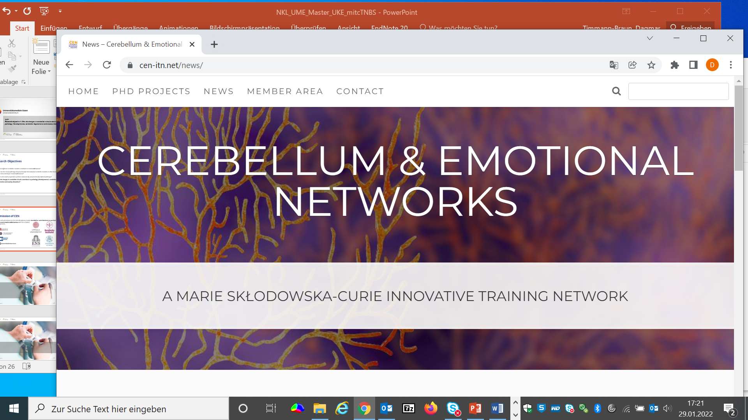
(Work package 4)
RO1: How do different cerebellar modules contribute to emotional behaviour?

Slide 9
Rodent studies of brain networks (ESRs 1-5) Cerebellar inter connectivity with survival circuits (eg periaqueductal grey, prefrontal cortex and thalamus)
Neuroanatomical, behavioural, electrophysiological, imaging and viral manipulation techniques
Cerebellar involvement in
fear conditioning and extinction
Cerebellar involvement in
defensive states
Cerebellar involvement in
anxiety phenotype
ESRs 1 and 2: Paris
ESR 4: Pavia
ESR 3: Wurzburg
ESR 5: Bristol
RO1: How do different cerebellar modules contribute to emotional behaviour?

Slide 10
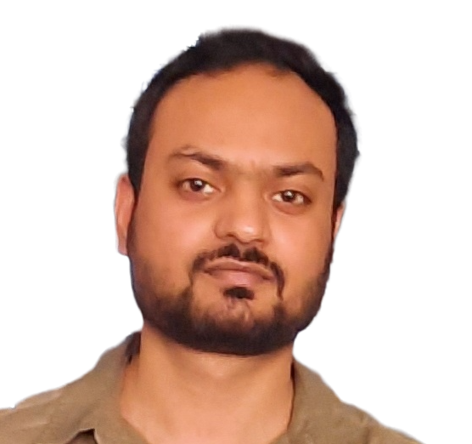
Early stage researchers
ESR1
Julie Urrutia Desmaison
ENS Paris
ESR2
Ahsan Ayyaz
ENS Paris
ESR3
To be appointed
University Hospital Würzburg
ESR4
Camilla Ciapponi
University of Pavia
ESR5
Vasiliki Spatharioti
University of Bristol
RO1: How do different cerebellar modules contribute to emotional behaviour?

Slide 11
Secondments / Training visits
ESR1:
ESR2:
ESR3:
Bristol: ephys data in rats
Blackrock systems: multichannel recording systems
Essen: human imaging; Wurzburg: Ca imaging.
Pavia: Ca imaging
Inscopix: miniscope technology
Cerevance: Biotech industry
ESR4:
ESR5:
Wurzburg: Ca imaging
Inscopix: miniscope technology
Wurzburg: viral vectors
Blackrock systems: multichannel recording systems
RO1: How do different cerebellar modules contribute to emotional behaviour?

