Slide 1
Network Meeting
3rd February 2022

Slide 2
Supervisory Board Agenda
3 February 2022
12.30 - 13.30 GMT / 13.30 - 14.30 CET
1. Updates from Vicky Walter, Project Manager
i. Overview of CEN structure
ii. CEN progress to date
iii. Training and development
2. Research co-operation
3. Any other business
4. Date of next meeting

Slide 3
Project Manager Update
1. Overview of CEN structure
Contracts/agreements
Consortium bodies
Role of Supervisory Board
2. CEN progress to date
Recruitment
Deliverables and milestones
Website
3. Training and development

Slide 4
CEN Governance – contracts/agreements
Grant Agreement (inc. Consortium Plan)
Consortium Agreement
Partner Agreements
Secondment Agreements
Advisory Board NDA
Data Transfer Agreement
Material Transfer Agreement

Slide 5
CEN Governance – Consortium bodies
Academic Assembly
Funding Authority
External Advisory Board
Supervisory Board
Network Coordinator/
Project Manager
Development Team
ESR Committee
Ethics Committee
Work Package Leads
Ethics Advisory Board

Slide 6
Role of the Supervisory Board
Terms of Reference – to be accepted at next meeting
Monitor project progress and implementation according to Consortium Plan
Oversee quality of supervision and training of ESRs and ensure balance between scientific and transferable skills
Help prepare for meetings with the Funding Authority and in preparing related data and deliverables
Assist with preparation of press releases and joint publications and meetings with Funding Authority

Slide 7
Recruitment
Recruitment round 1 and 2
Call for applications
Criteria: mobility and career stage
Advertised: Euraxess, website, FENS, networks
Shortlisting
CEN selection criteria
Interviews
Presentations
Supervisors and co-supervisors, others from host
References
Recruitment round 3
Call for applications
Additional criteria
Shortlisting
Task
Interviews
References

Slide 8
Recruitment
Round 1
Advertised 13 positions
Received 107 applications
Held 21 interviews
Recruited 8 ESRs
Round 2
Advertised 5 positions
Received 71 applications
Held 15 interviews
Recruited 4 ESRs
Round 3
Advertised 2 positions
Received 226 applications
Held 8 interviews
Recruited 2 ESRs

Slide 9
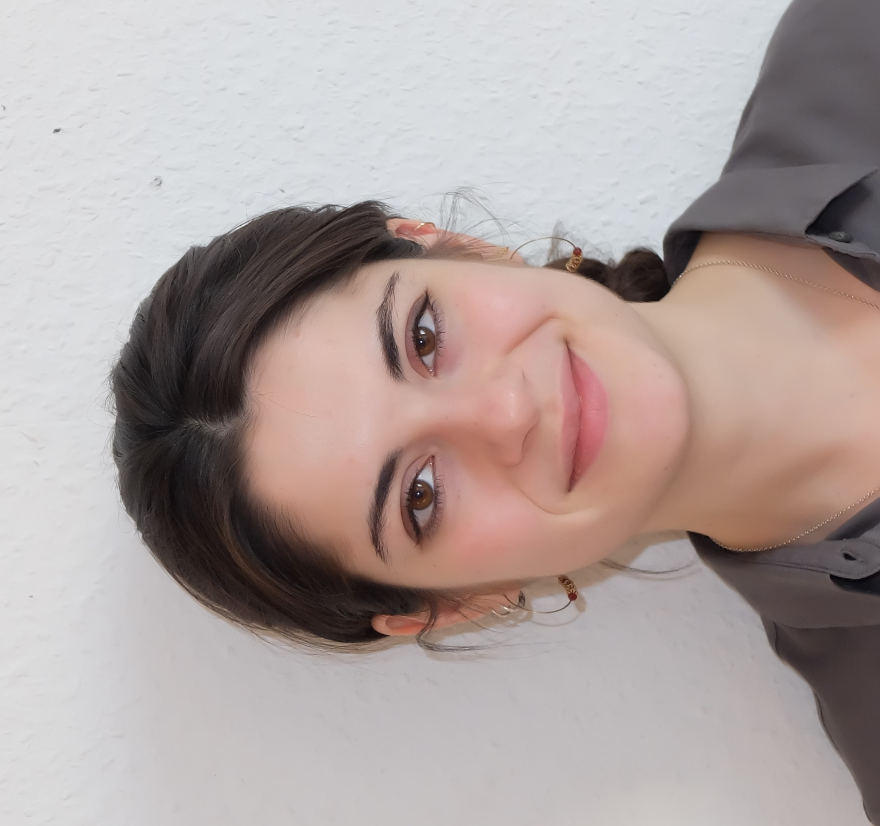
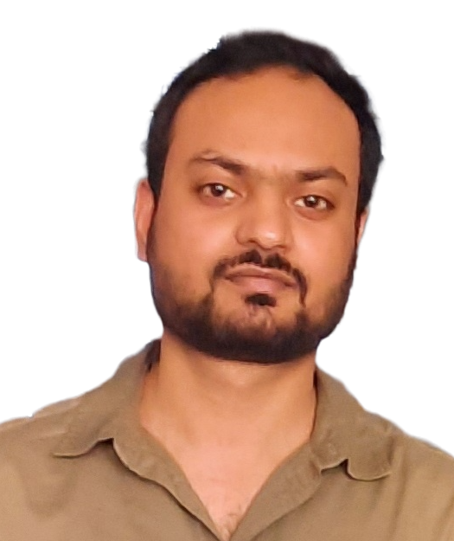
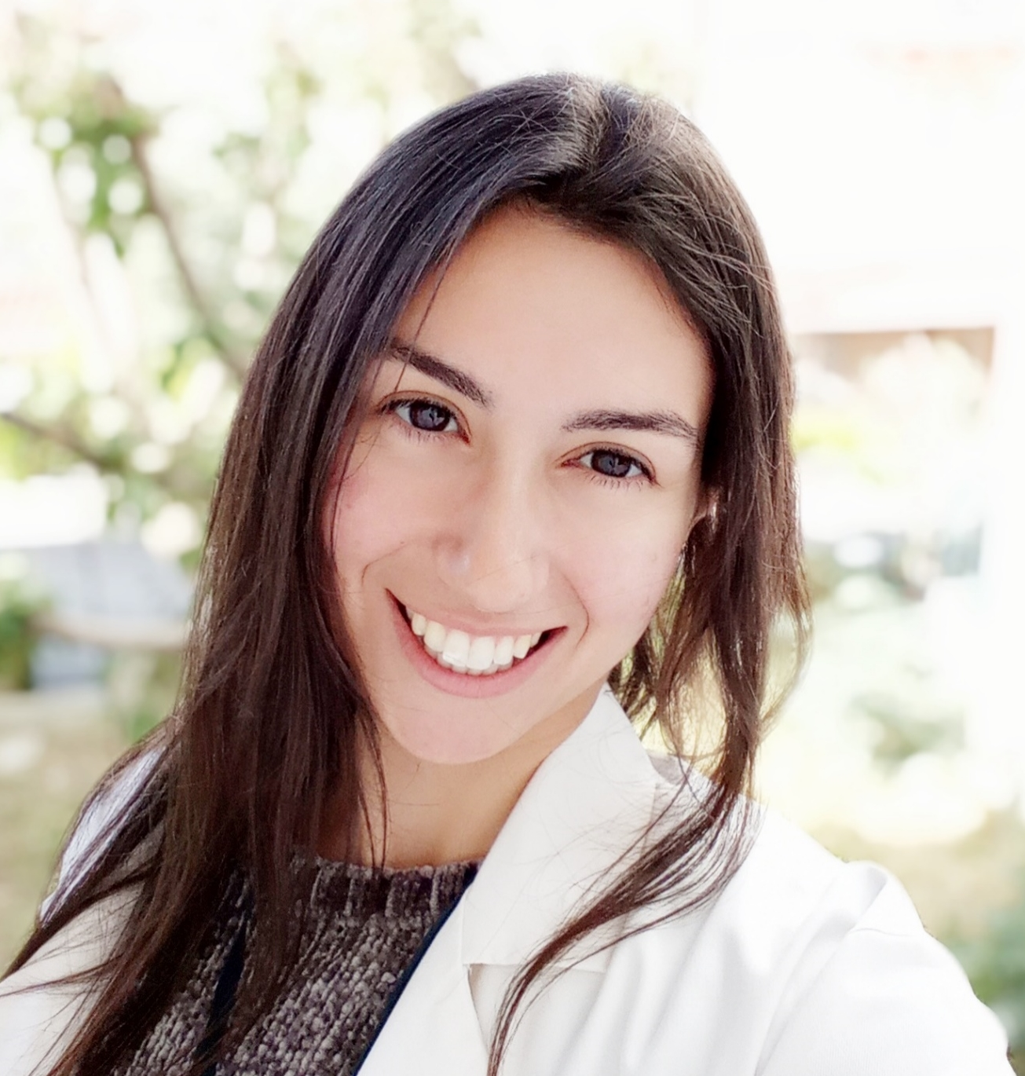
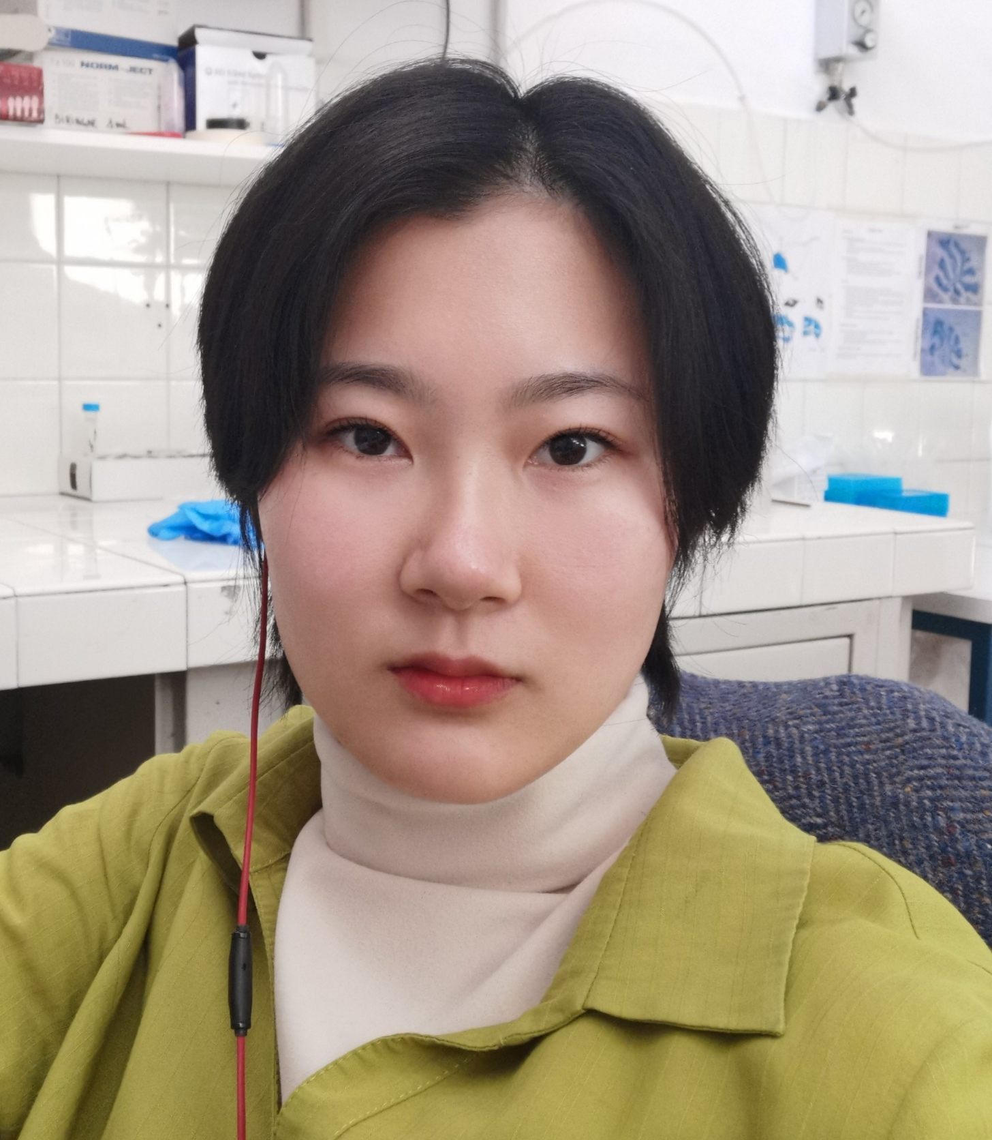
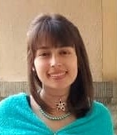
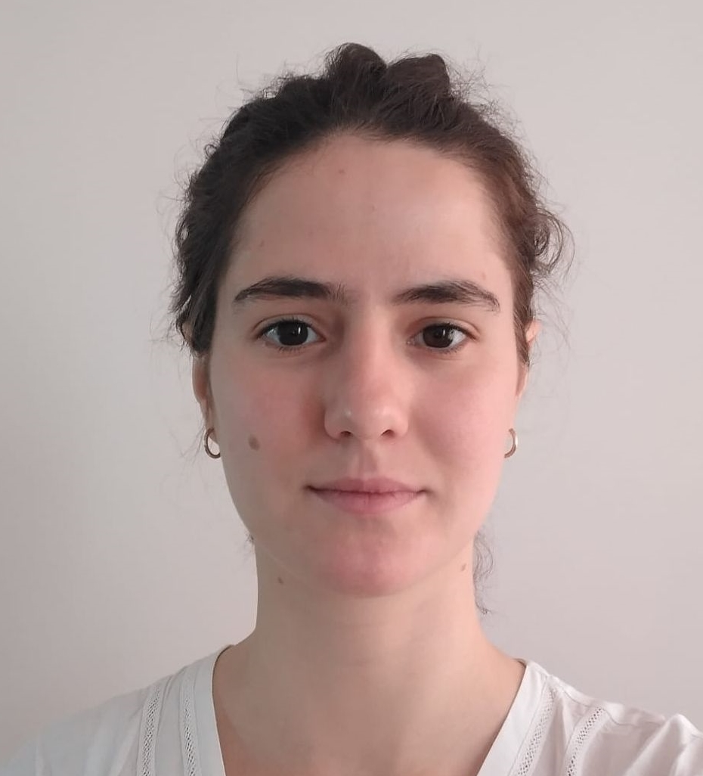
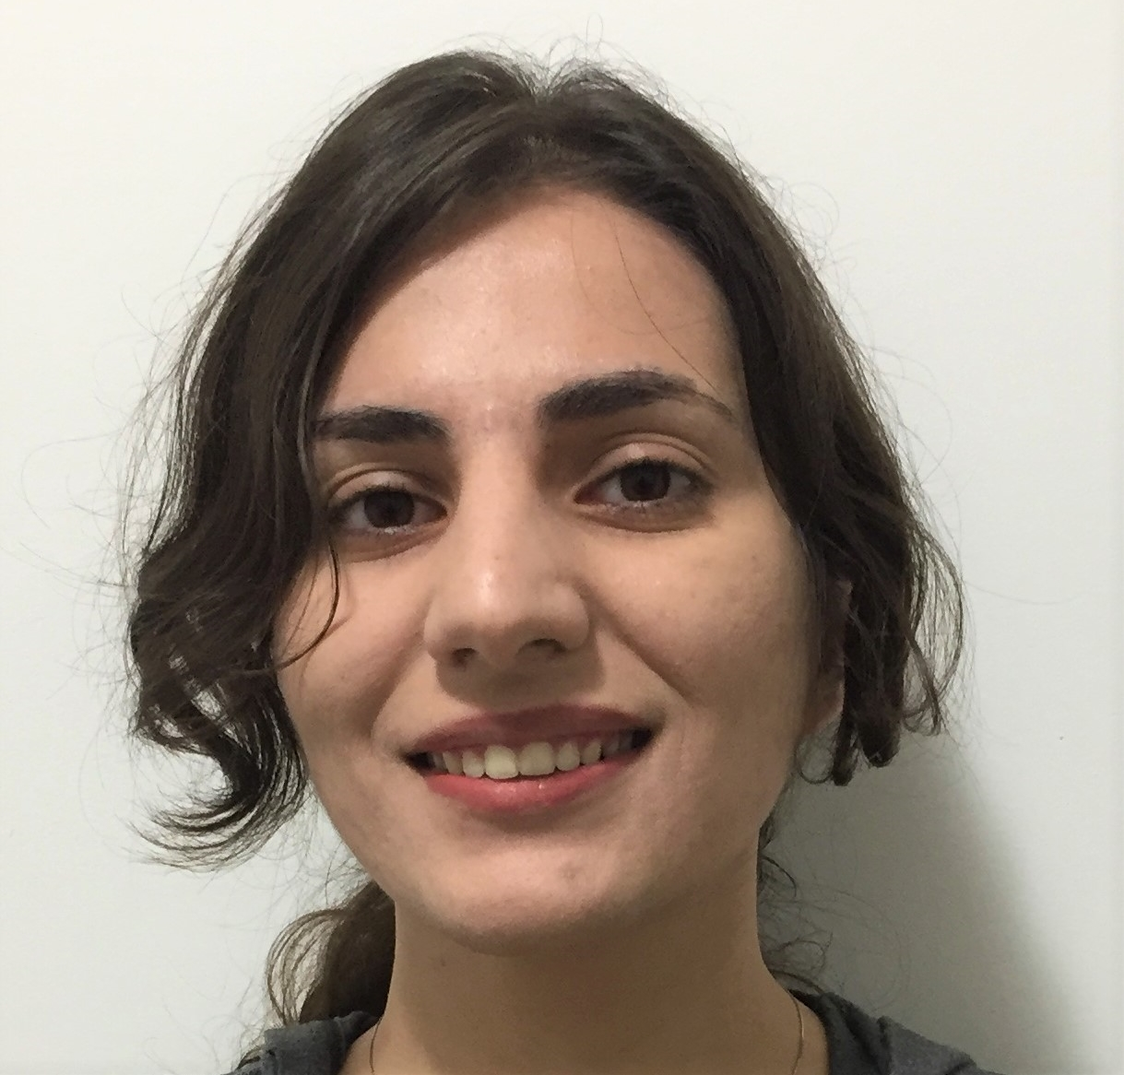
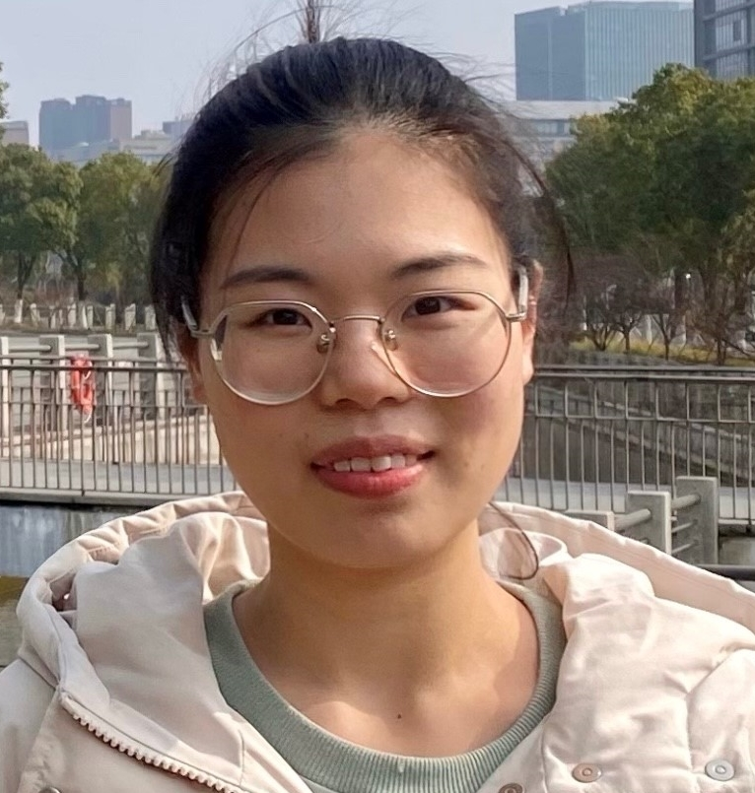
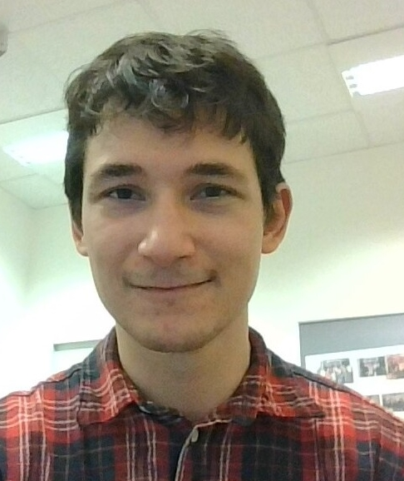
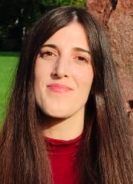
Julie Urrutia Desmaison
Ahsan Ayyaz
To be appointed
Camilla Ciapponi
Vasiliki Spatharioti
Gabriela Neubert da Silva
Fernando Senovilla Sanz
Yuhe Li
Dianela Osorio Becerra
Alice Doubliez
Mahdie Ghane Ezabadi
Jingjing Ye
Enzo Nio
Tuğçe Yildiz
Patricia Gil Paterna

Slide 10
Continuous Reporting - Deliverables
WP1 Management |  | WP2 ESR Development |  | WP3 Ethics |  | WP 4-7 Research Objectives |  | WP8 Dissemination
Supervisory Board reps | Jul 21 | Career Development Plan for each ESR | Jun 22 | Humans – informed consent | Oct 21 | Presentation at international conference | May 24 | Establish CEN identity (logo, templates etc.) | Jul 21
Consortium Agreement | Nov 21 | Joint review article by ESRs | Nov 22 | Data processing | Oct 21 | Develop manuscripts for submission | May 25 | Establish website | Aug 21
Advertisements of ESR posts | Aug 21 | Mini symposium proposal submitted to SFN 2022 | May 23 | Animals - authorisations | Sep 22 |  |  | Press releases for CEN | Jul 21
Data Manage-ment Plan | Nov 21 | Publication for a lay readership | May 23 | Facilities - authorisations | Sep 22 |  |  | Active participation in Brain Awareness Week campaign 2022 | May 22
Progress Report | Jun 22 |  |  | Ethics report | Feb 22
Potential inputs for policy feedback | May 25 |  |  | Ethics report | May 23
 |  |  |  | Ethics report | May 25

Slide 11
Continuous Reporting – Deliverables
WP1 Management |  | WP2 ESR Development |  | WP3 Ethics |  | WP 4-7 Research Objectives |  | WP8 Dissemination
Supervisory Board reps | Jul 21 | Career Development Plan for each ESR | Jun 22 | Humans – informed consent | Oct 21 | Presentation at international conference | May 24 | Establish CEN identity (logo, templates etc.) | Jul 21
Consortium Agreement | Nov 21 | Joint review article by ESRs | Nov 22 | Data processing | Oct 21 | Develop manuscripts for submission | May 25 | Establish website | Aug 21
Advertisements of ESR posts | Aug 21 | Mini symposium proposal submitted to SFN 2022 | May 23 | Animals - authorisations | Sep 22 |  |  | Press releases for CEN | Jul 21
Data Manage-ment Plan | Nov 21 | Publication for a lay readership | May 23 | Facilities - authorisations | Sep 22 |  |  | Active participation in Brain Awareness Week campaign 2022 | May 22
Progress Report | Jun 22 |  |  | Ethics report | Feb 22
Potential inputs for policy feedback | May 25 |  |  | Ethics report | May 23
 |  |  |  | Ethics report | May 25

Slide 12
Continuous Reporting – Milestones
Title | Deliverable description / milestone means of verification | Month | Due date
Inauguration of Boards, Committees and Teams | Release of inaugural meeting minutes | 7 | 31 December 2021
Recruitment of ESRs completed | ESR contracts in place across all beneficiaries | 12 | 31 May 2022
All recruited fellows enrolledin PhD programme | Recruited ESRs enrolled | 12 | 31 May 2022
Experimental set-ups established including calcium imaging, viral tracing and fMRI studies | Reports of ESRs | 13 | 30 June 2022
Project Check | Meeting between REA and Consortium | 15 | 31 August 2022
Pilot data acquired | Reports of ESRs | 18 | 30 November 2022
Behavioural data sent to Pavia for computational modelling | Reports of ESRs | 24 | 31 May 2023
Secondments (minimum of 15 months) | Secondments in place, report of ESRs | 24 | 31 May 2023
Secondments (minimum of 30 months) | Secondments completed, reports of ESRs | 48 | 31 May 2025

Slide 13
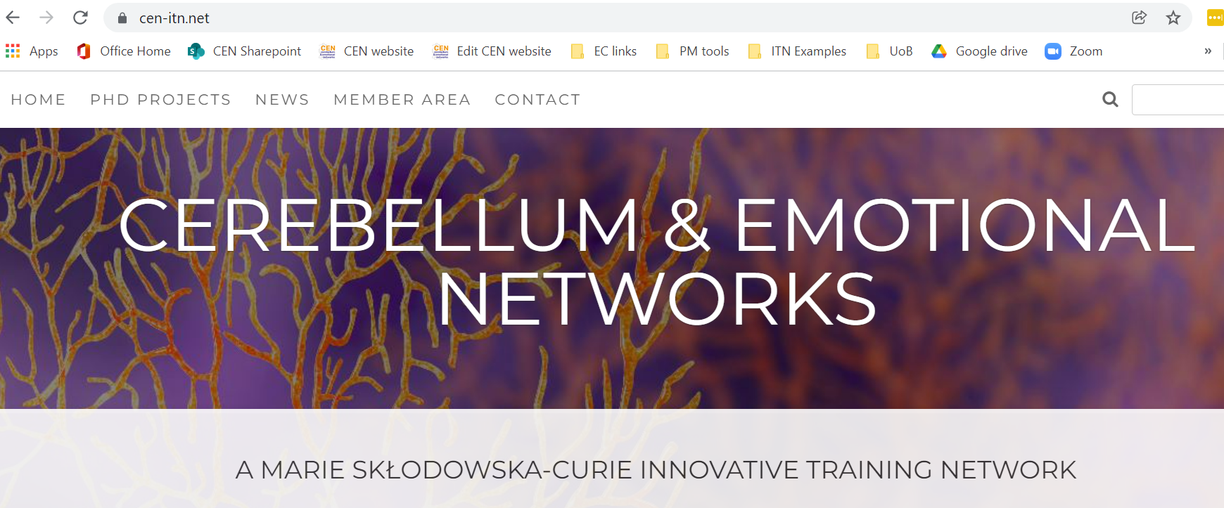
Website

Slide 14
Training and development
Relationships in host labs
Alignment with local PhD programmes
Host training courses
Involvement in ethics proposals or undergraduate teaching
through local institutional networks
Co-supervision
Mentoring
Secondments
Partner training sessions
Network Meetings
Workshops
Webinars
Dissemination activities
Partner training sessions
interwoven networks between ESR projects involved within and across WPs
through whole network teaching

Slide 15
Training and development
ESRs and Supervisors
ESR Committee
Development Team
Supervisory Board

Slide 16
Training and development
ESRs and Supervisors
ESR Committee
Development Team
Two supervisors, two senior postdocs and two ESRs (from different institutions) and two representatives from non-academic partners.
Supervisory Board

